Slide 1
kutsehariduskeskus.ee

Slide 2
Who we are?
Biggest state-run vocational school in Estonia.
2300 students
100+ curricula
3 cities
01
kutsehariduskeskus.ee

Slide 3
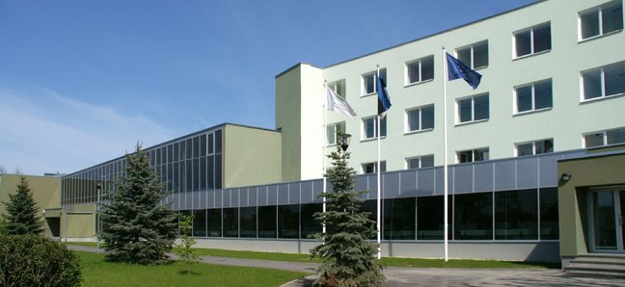
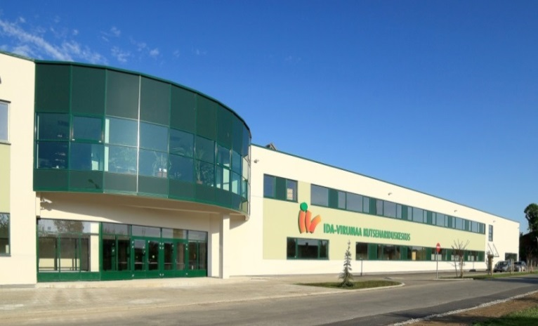
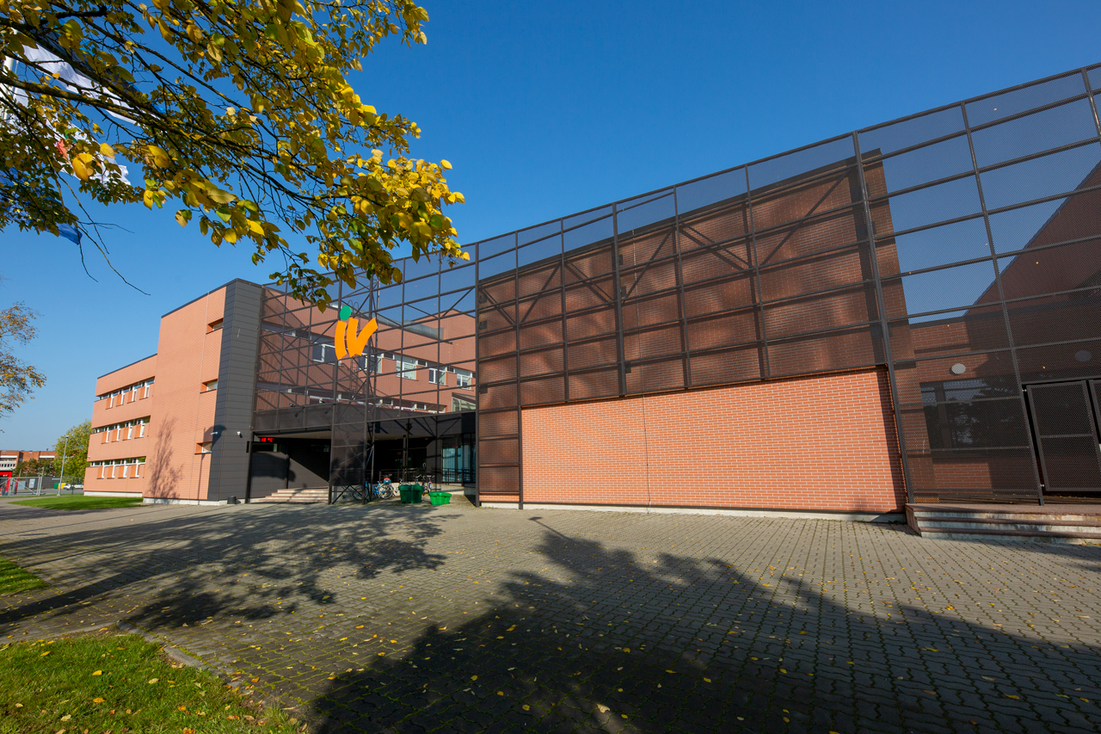
Where we are?
Narva
Jõhvi
Sillamäe
02
kutsehariduskeskus.ee

Slide 4
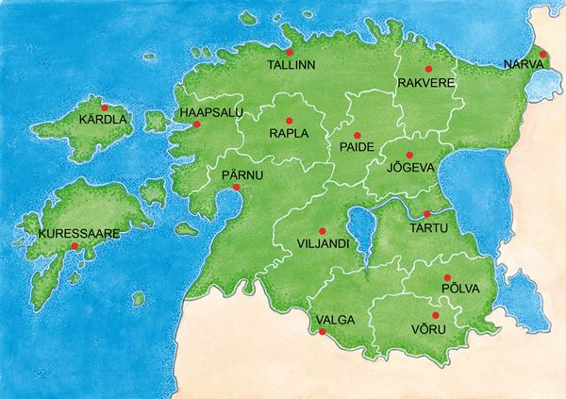
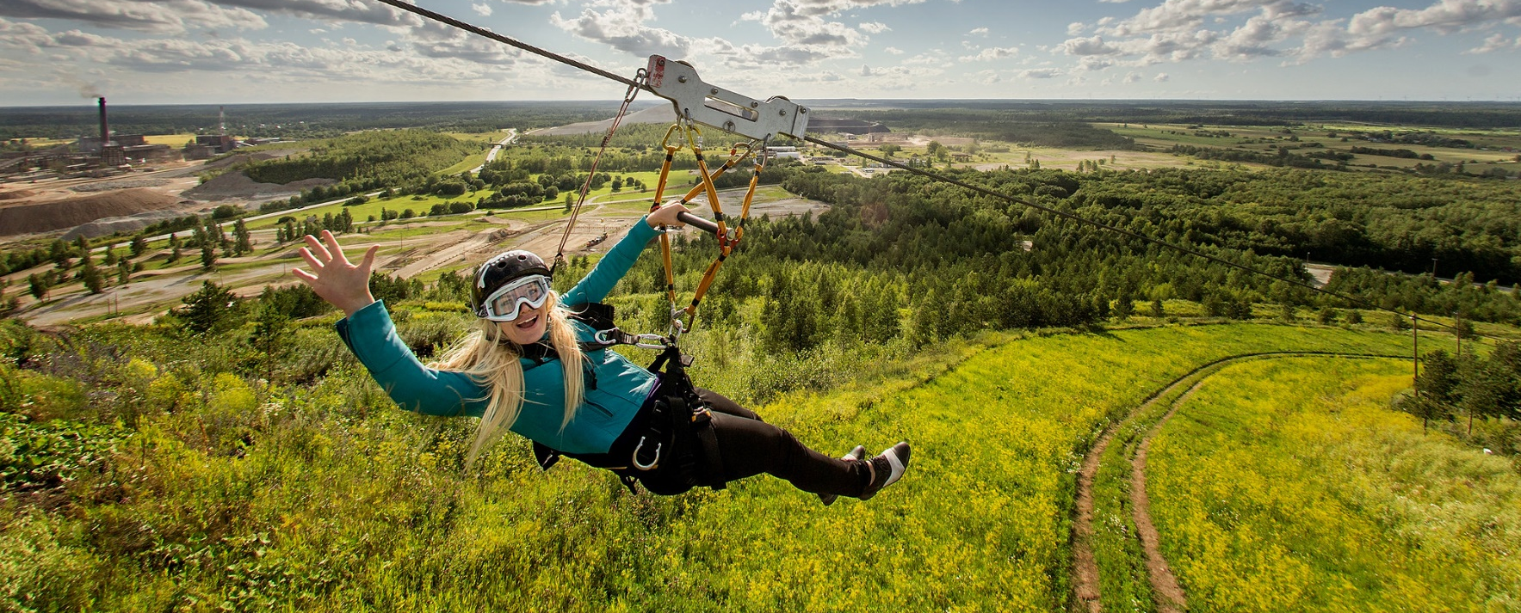
Ida-Virumaa, Land of Adventures
The county of Ida-Virumaa, with its diverse nature, cultural traditions and sights, is situated in the north-east Estonia, on the southern coast of the Gulf of Finland and the eastern border of the European Union.
Known for oil shale mines, chemical plants and power stations but also for spectacular nature and excellent leisure activities.
03
kutsehariduskeskus.ee

Slide 5
Our Mission
Reflecting the school community's values, we equally prioritize mastery, environmental consciousness, entrepreneurship, innovation, and collaboration.
Our students will became entrepreneurial environmentally aware innovative masters.
Our mission is to be lifelong learning center contributing to regional development.
04
kutsehariduskeskus.ee

Slide 6
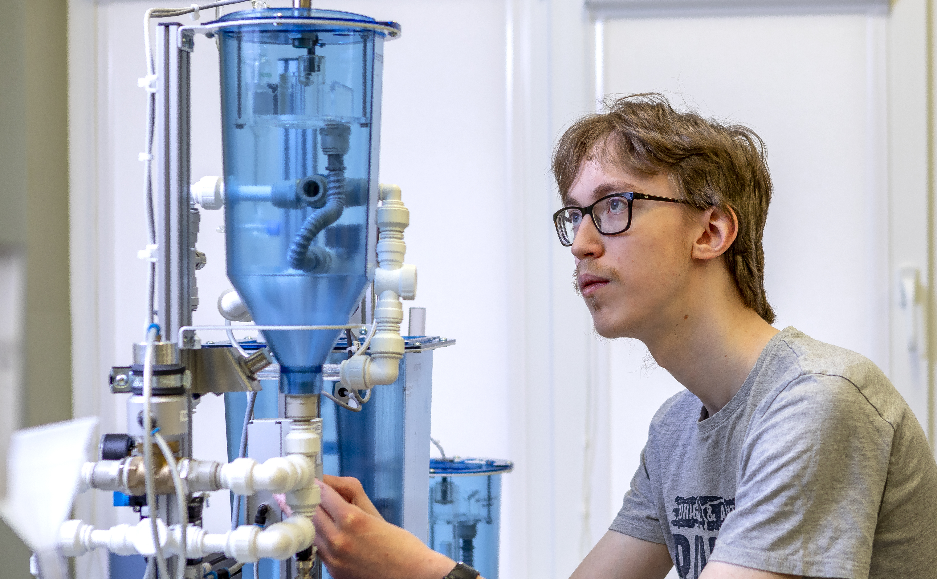
We offer
Free education
Free transportation
International internships
Vocational exam for free
Scholarships and travel allowance
Free school lunch
Support services
Student dormitories
Active student council and
extracurricular activities
05
kutsehariduskeskus.ee

Slide 7
You can study
On the basis of secondary education or acquiring a new specialization in vocational education.
06
kutsehariduskeskus.ee

Slide 8
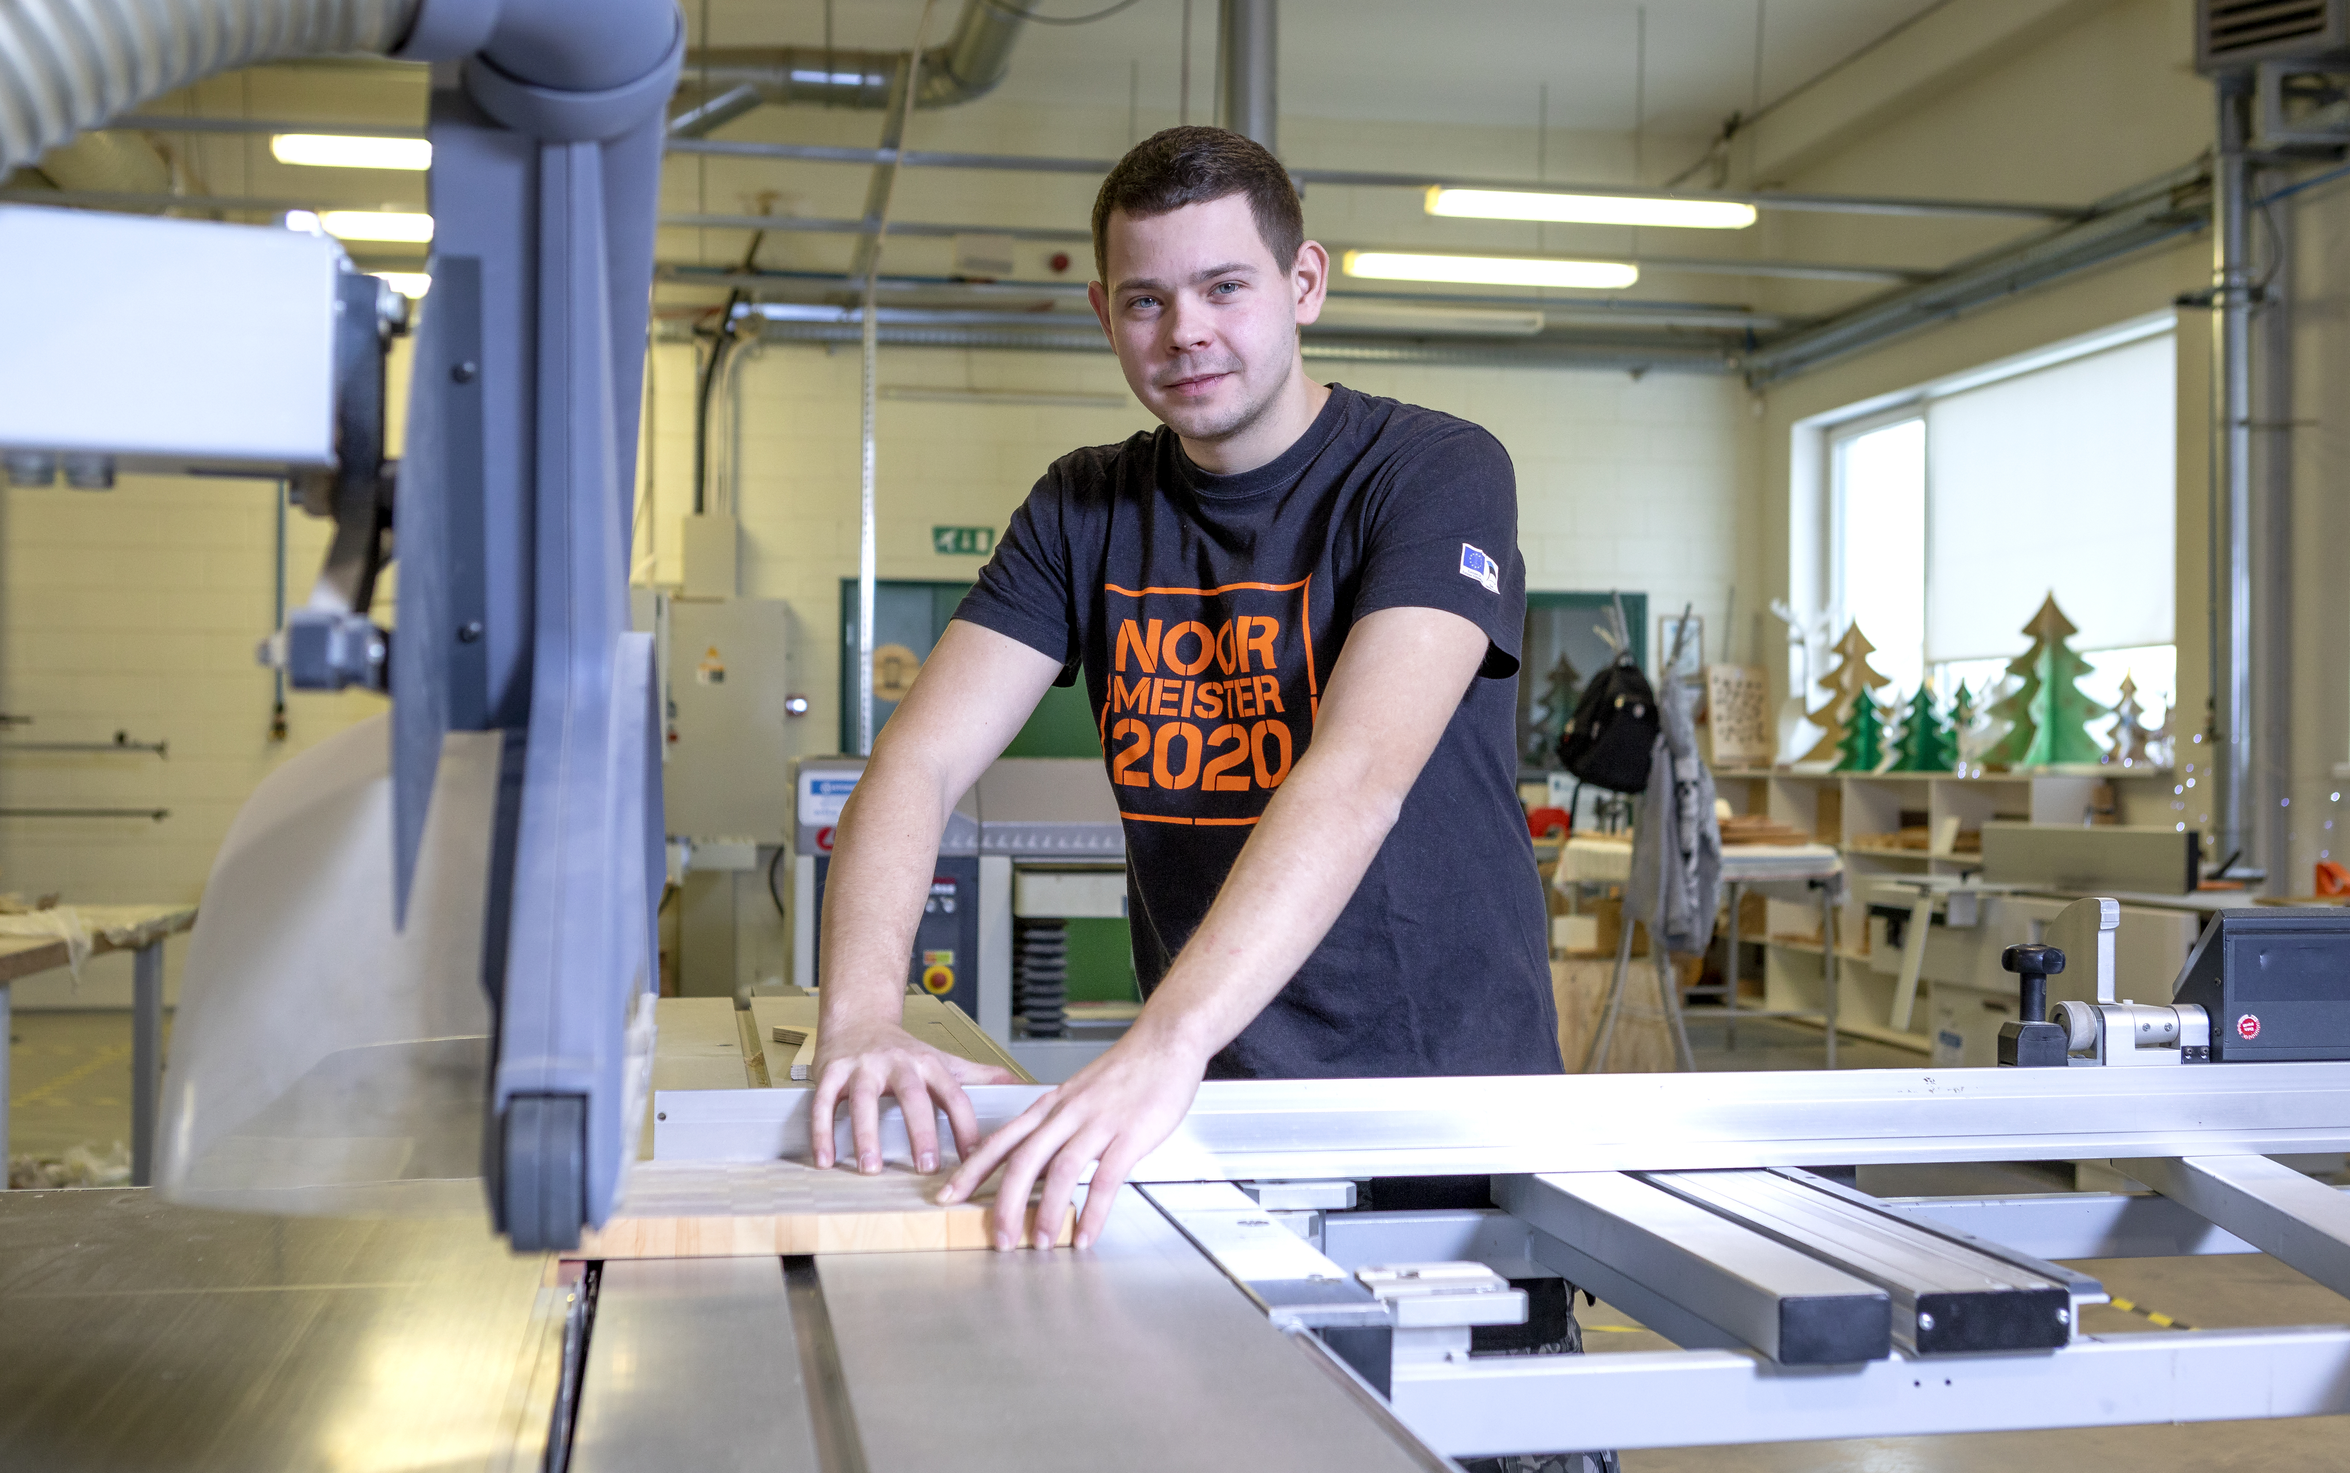
Areas of study
Engineering and Technology
Economics and IT
Services
Curricula are offered both at school and on work-based learning schemes, daytime or evening. Instruction languages are estonian and russian.
07
kutsehariduskeskus.ee

Slide 9
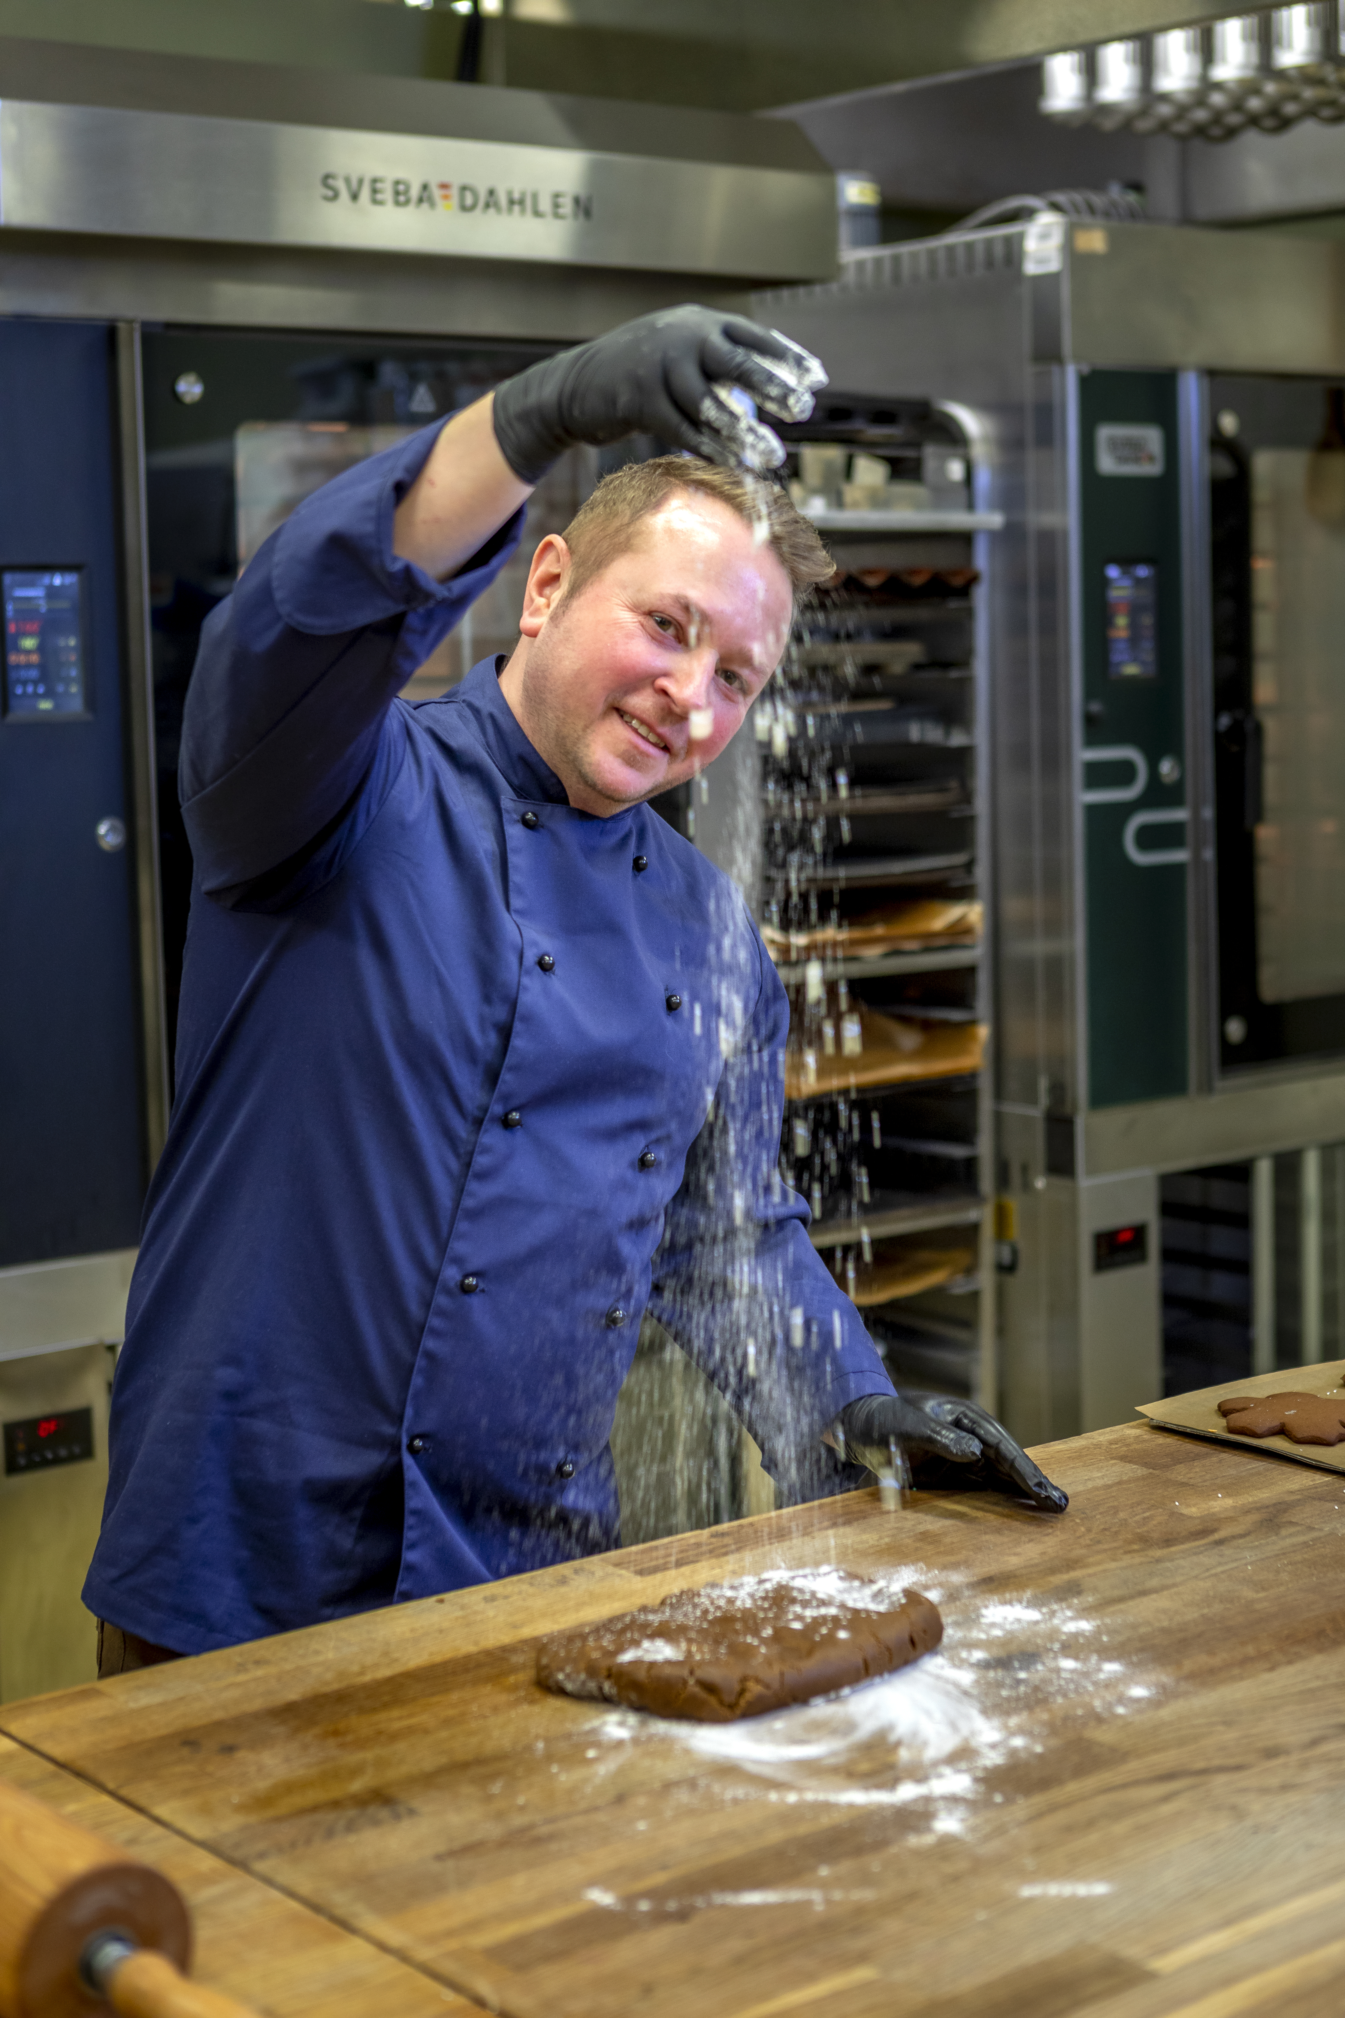
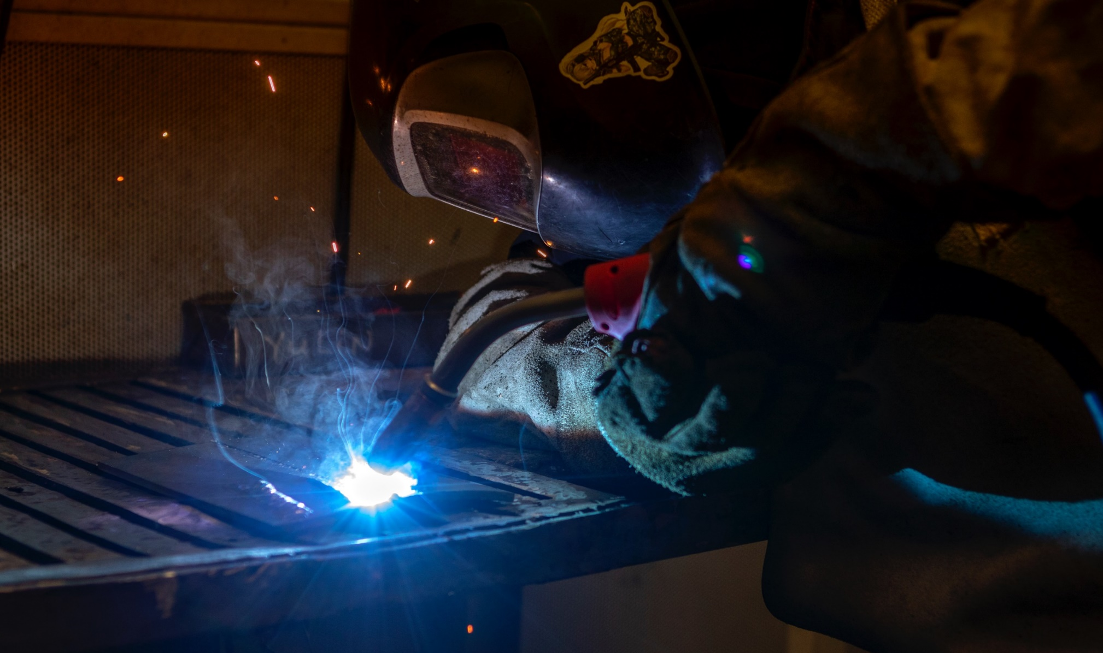
Life-long learning
We offer variety of courses!
08
kutsehariduskeskus.ee

Slide 10
Ministry of Education
and Research
Management
Council
Director
Advisory Board
Aastate jooksul on erinevad kutsehariduskoolid ümberkorraldatud, ühendatud ja ümbernimetatud. Täna kutsehariduskeskus kannab nime Ida-Virumaa Kutsehariduskeskus.
Assistant
Quality Manager
Working Environment
Specialist
HR Manager
Academic
Director & Department
Finance and Administration
Director & Department
Marketing
Director & Department
Department of General Education / Department of Services, Department of Economics and IT, Department of Engineering and Technology, Support Centre, Adult Learning
Marketing / International relations (Erasmus+) / Extracurricula activities / Projects
Financial service, Administrative service and IT service
09

Slide 11
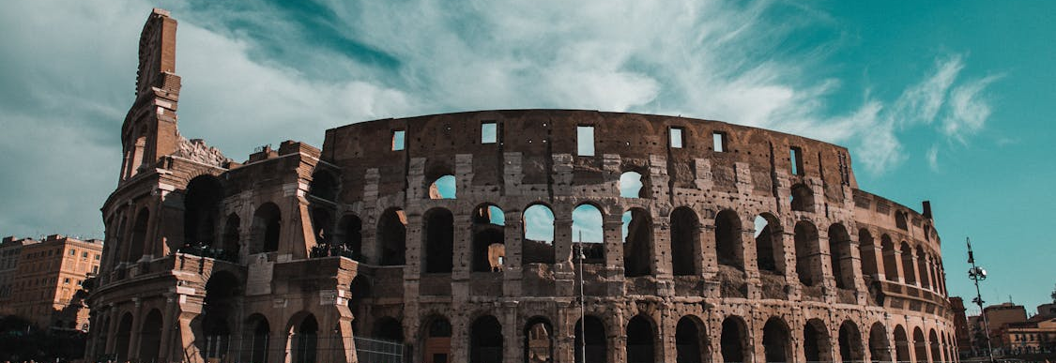
International co-operation
Erasmus+ & European projects
10
kutsehariduskeskus.ee

Slide 12
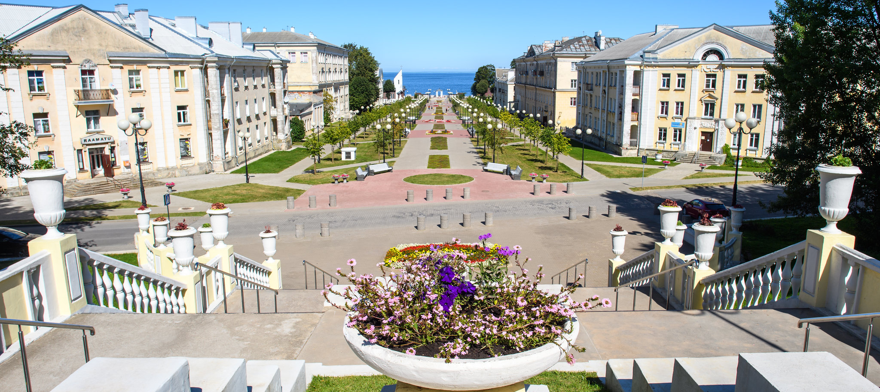
Dormitories
Sillamäe dormitory - 200 persons
Jõhvi dormitory - 100 persons
11
kutsehariduskeskus.ee

Slide 13
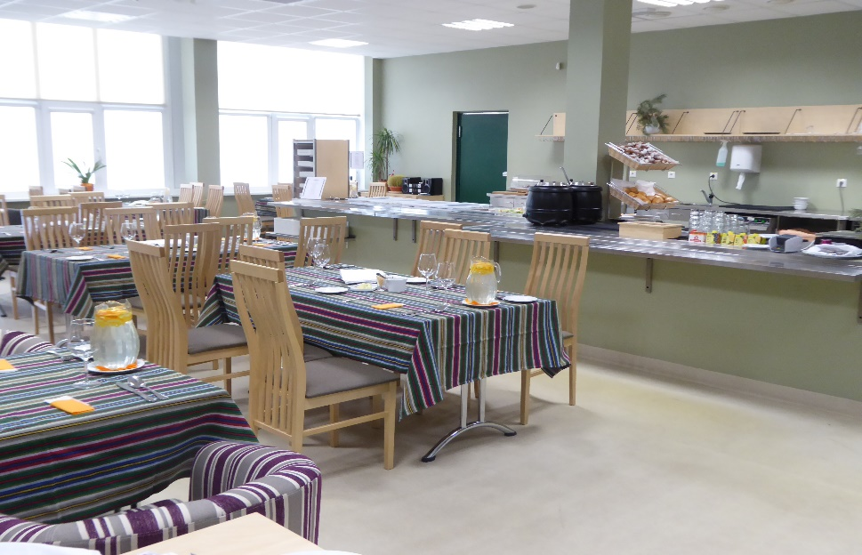
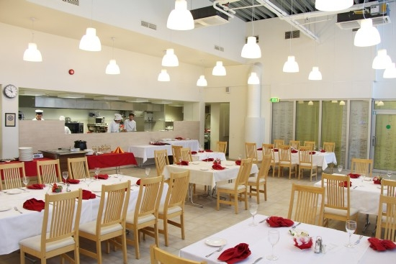
Restaurants
Manufaktuur
Kreenholmi 45, Narva
12
kutsehariduskeskus.ee

Slide 14
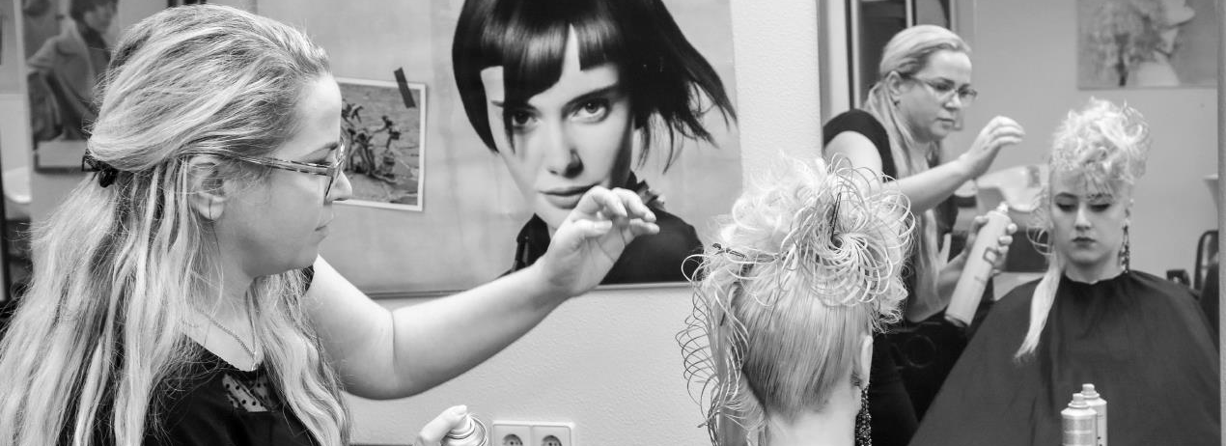
Beauty salon La Beaute
All the services are provided by our students under the guidance of an experienced teacher.
13
kutsehariduskeskus.ee

Slide 15
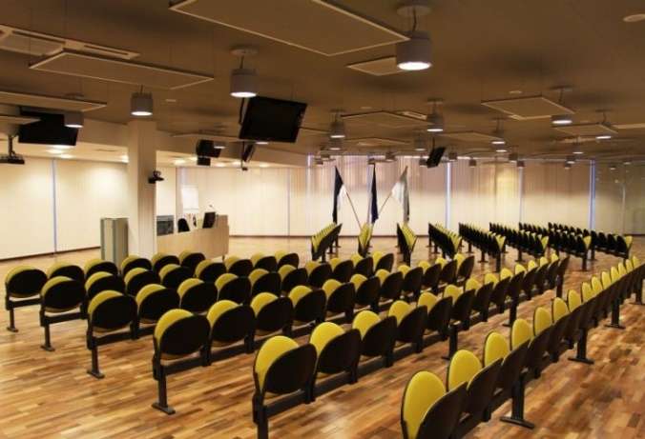
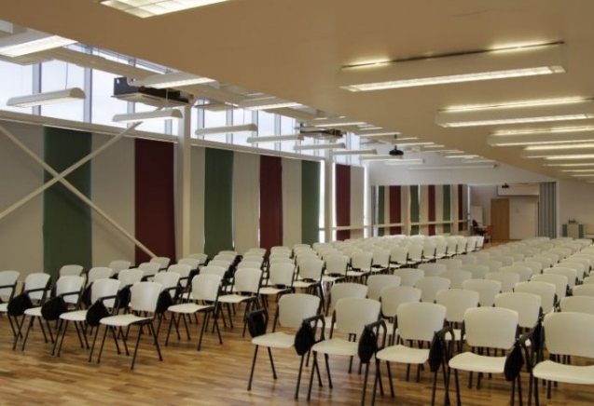
Conferences and Seminars
Conference halls with seating capacities up to 200 people.
Catering and accommodation at our dorms or partner hotels.
14
kutsehariduskeskus.ee

Slide 16
Thank you for listening!
The sun rises from the east.

